Slide 1

HMM
정보통신공학과 이승호

Slide 2

Markov Chain
HMM
Likelihood
Viterbi
Forward-Backward
INDEX

Slide 3

1. Markov chain

Slide 4
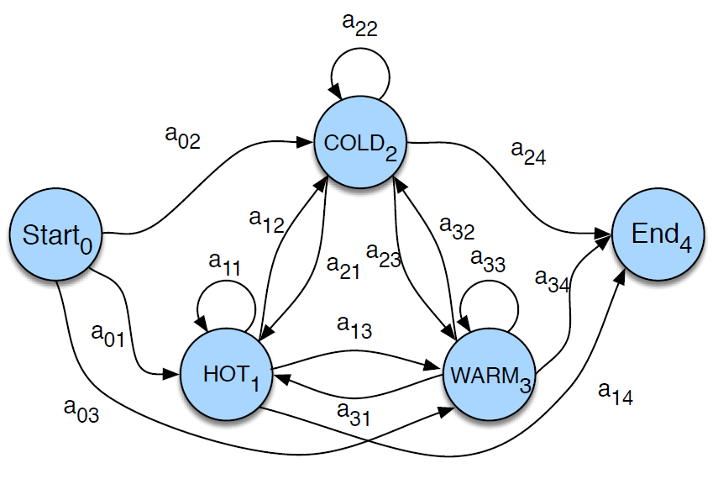


Markov chain
first-order Markov chain, the probability of a particular state depends
Only on the previous state

Slide 5
2. HMM

Slide 6
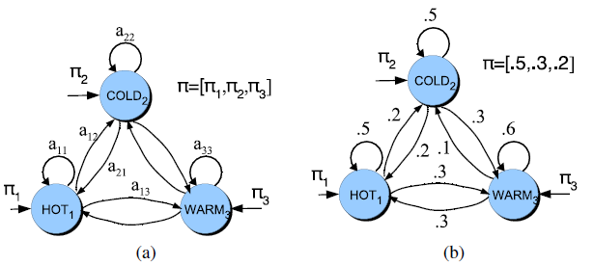
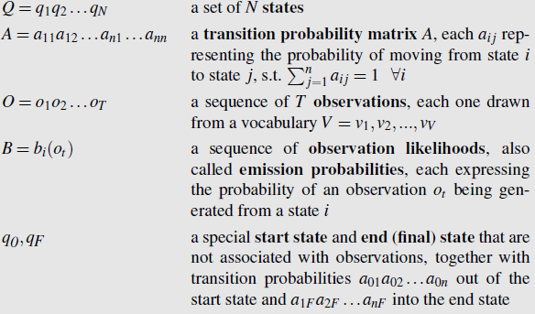
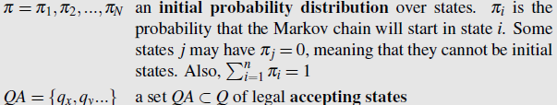
HMM
The events we are interested in may not be directly observable in the world.

Slide 7
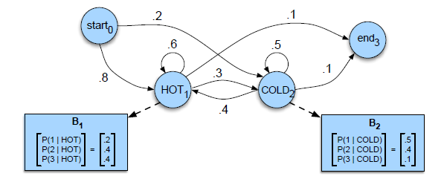
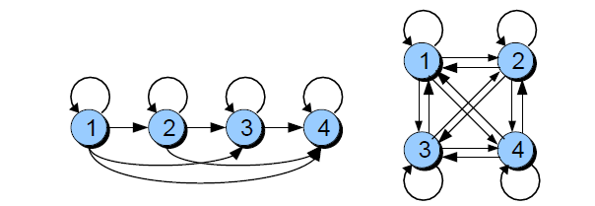
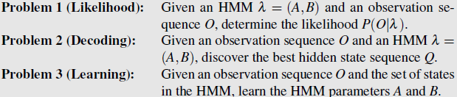
HMM

Slide 8
3. Likelihood

Slide 9

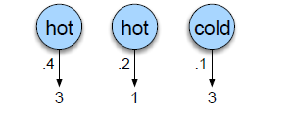



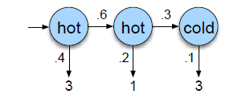
Likelihood
Computing Likelihood: Given an HMM λ =(A,B) and an observation sequence O
Determine the likelihood P(O|λ)

Slide 10

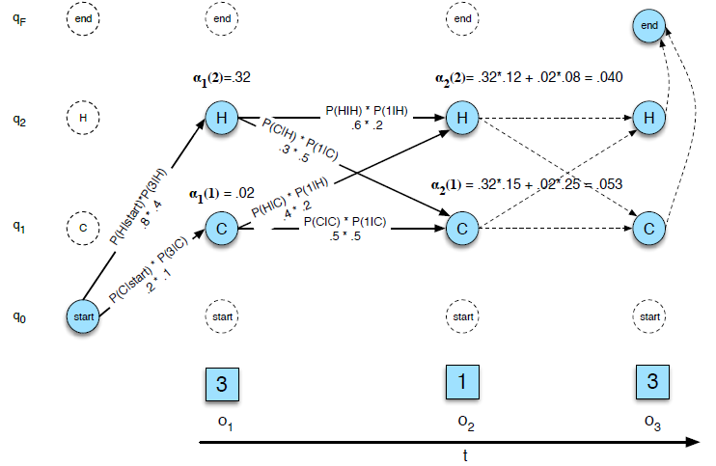

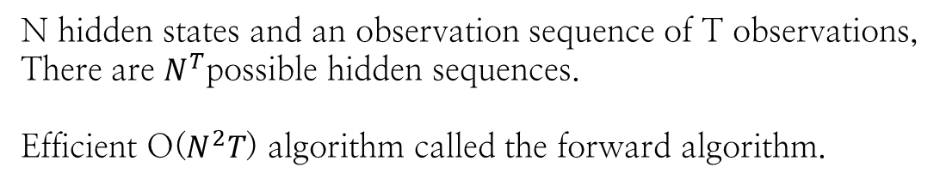
Dynamic Programming
N hidden states and an observation sequence of T observations,
There are $N^{T}$possible hidden sequences.
Efficient O($N^{2}T$) algorithm called the forward algorithm.

Slide 11
4. Viterbi

Slide 12

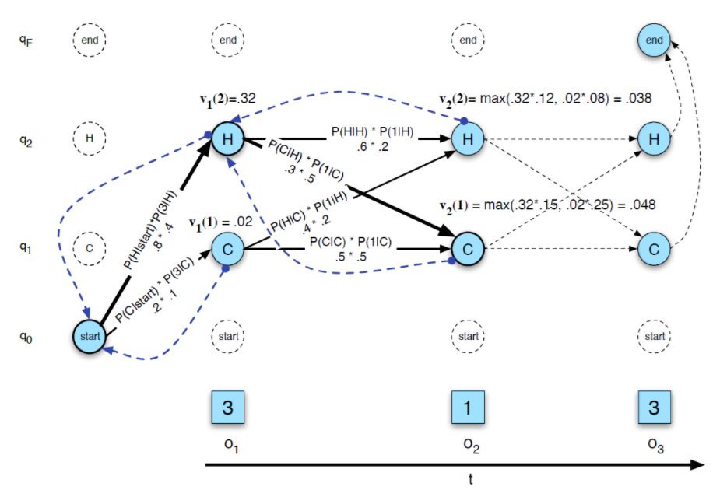
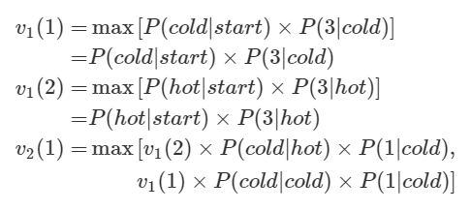

Viterbi Algorithm

Slide 13
5. Forward Backward algorithm

Slide 14

감사합니다.
이 문서는 나눔글꼴로 작성되었습니다. 설치하기

